Slide 1
Database Design & normalization

Slide 2
Why?
Why ? Why ? Why?
Why we need to talk about database design?
Actually there is a very deep bounding between OO and Database

Slide 3
Some History about DataBase
There is a time about how to store a database
Several data structures are used and implemented in commercial products
  Tree (pointer)
  Graph (pointer)
  Linked list of …
  ….
  Hetrogenious

Slide 4
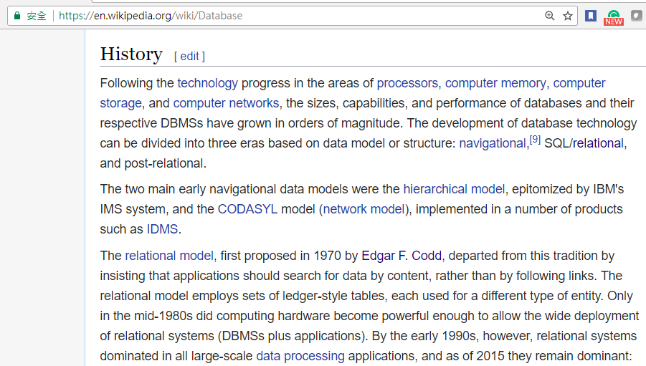

Slide 5
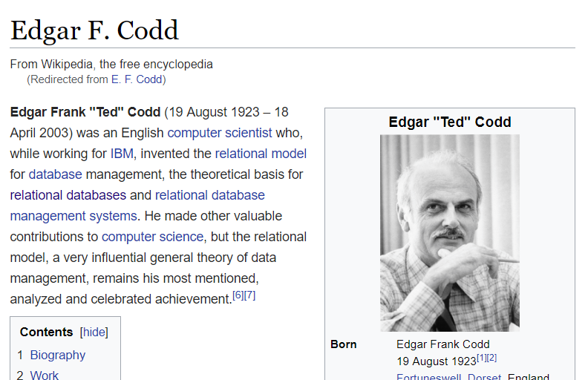
The Father of relational database

Slide 6
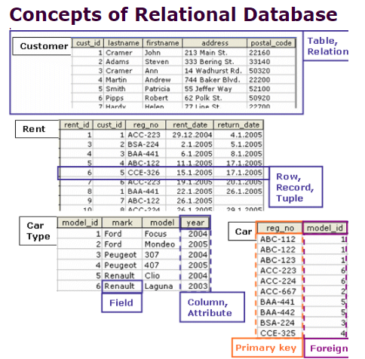

Slide 7
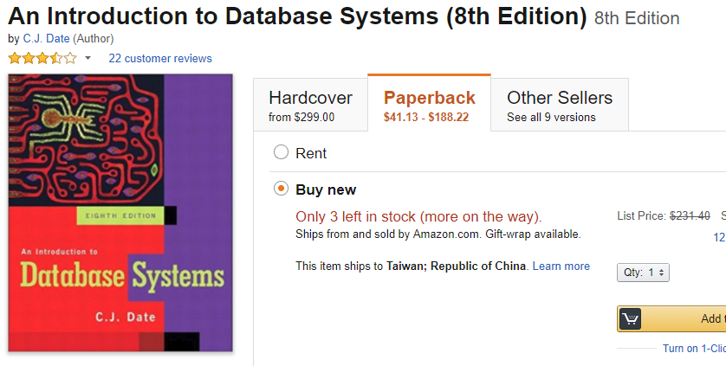
If you really want to know deeper about normalization

Slide 8
Writing a DB application
Well, it is considered an easy topic in CS but mostly emphasized in MIS
If you know DBMS programming, it won’t make you get paid higher
Why should we care?

Slide 9
Let’s start with an example.
Say you need a sales report something like this:
Customer Catalog Unit Qty Actual Extended
No. Name Address No. Description Price Date Sold Price Price
131 Jo Blo 13 May St 3A21 T-Shirt 12.49 03/01/98 45 10.00 450.00
179 Yo Yo 271 OK Ave 1B77 Sweats 15.00 01/03/98 12 15.00 180.00
212 Mu Mu 32 Saddle Rd 4X21 Pants 23.47 12/11/98 5 21.00 105.00
. . . . . . . . . .
. . . . . . . . . .
. . . . . . . . . .

Slide 10
What the uninitiated (read “amateur”) database
designer tends to do
is to build a relational table
that mimics this report.
That is, it has the same columns as this report.
But what would we call this class?
The best name would probably be something like “Sales” or “Sales Analysis.”
But . . .

Slide 11
The problem is that we have three kinds
  of data in this report.
We have:
Data that describes a Customer (Cust No./Name/Address)
Data that describes a Product
  (Cat No/Description/Unit Price)
And data that describes a Sale (Date/Quantity/Actual and Extended Prices)
Compare this situation with all the earlier models we have looked at,
You’ll see that Customer, Product and Sale should each be a separate class . . .

Slide 12
The maintenance horror of the poorly designed database
A customer can continuously buy several kinds of product.
What if he change his name?
What if the price of a product is increased or decreased?
What if a customer change its address?

Slide 13
What is the problem of the amateur’s database design?
This structure does not allows our database to answer
any query
that could possibly be dreamed up
against that data.
Some query can be done but very inefficient

Slide 14
The “Un-normalized” structure that mimicked the report will have problems ,
down the line a few months or years,
Attempting to answer queries
that the database designer did not foresee -
What I refer to as:
“That most dreaded of all database phenomena,
Unanticipated Queries”

Slide 15
Normalization
What Normalization is for
is to make sure
that each database table carries only the attributes
that actually describe
What is needed.

Slide 16
Normalization
Definition: Normalization is the process of structuring relational database schema such that most ambiguity is removed. The stages of normalization are referred to as normal forms and progress from the least restrictive (First Normal Form) through the most restrictive (Fifth Normal Form). Generally, most database designers do not attempt to implement anything higher than Third Normal Form or Boyce-Codd Normal Form.

Slide 17
A simpler explanation to normalization
There are two goals of the normalization process:
eliminate redundant data (for example, storing the same data in more than one table) and
ensure data dependencies make sense (only storing related data in a table). Both of these are worthy goals as they reduce the amount of space a database consumes and ensure that data is logically stored.

Slide 18
Normal forms
The database community has developed a series of guidelines for ensuring that databases are normalized. These are referred to as normal forms and are numbered from one (the lowest form of normalization, referred to as first normal form or 1NF) through five (fifth normal form or 5NF).
In practical applications, you'll often see 1NF, 2NF, and 3NF along with the occasional 4NF. Fifth normal form is very rarely seen and won't be discussed in this article.

Slide 19
Normal form hierarchy
First normal form (1NF) sets the very basic rules for an organized database:
  Eliminate duplicative columns from the same table.
  Create separate tables for each group of related data and identify each row with a unique column or set of columns (the primary key).
Second normal form (2NF) further addresses the concept of removing duplicative data:
  Meet all the requirements of the first normal form.
  Remove subsets of data that apply to multiple rows of a table and place them in separate tables.
  Create relationships between these new tables and their predecessors through the use of foreign keys.
Third normal form (3NF) goes one large step further:
  Meet all the requirements of the second normal form.
  Remove columns that are not dependent upon the primary key.
Finally, fourth normal form (4NF) has one additional requirement:
  Meet all the requirements of the third normal form.
  A relation is in 4NF if it has no multi-valued dependencies.

Slide 20
1ST NF
Eliminate duplicative columns from the same table.
Create separate tables for each group of related data and identify each row with a unique column or set of columns (the primary key).

Slide 21
An classic example
a table within a human resources database that stores the manager-subordinate relationship.
For the purposes of our example, wel impose the business rule that each manager may have one or more subordinates while each subordinate may have only one manager.

Slide 22
An intuitive table
Manager | Subordinate1 | Subordinate2 | Subordinate3 | Subordinate4
Bob | Jim | Mary | Beth
Mary | Mike | Jason | Carol | Mark
Jim | Alan

Slide 23
Why it is not even 1st NF?
recall the first rule imposed by 1NF: eliminate duplicative columns from the same table.? Clearly, the Subordinate1-Subordinate4 columns are duplicative.
Jim only has one subordinate, the Subordinate2-Subordinate4 columns are simply wasted storage space
Furthermore, Mary already has 4 subordinates ?what happens if she takes on another employee? The whole table structure would require modification.

Slide 24
A second bright idea
Let try something like this:
Manager Subordinates Bob Jim, Mary, Beth Mary Mike, Jason, Carol, Mark Jim Alan This solution is closer, but it also falls short of the mark
The subordinates column is still duplicative and non-atomic. What happens when we need to add or remove a subordinate?? We need to read and write the entire contents of the table.? That not a big deal in this situation, but what if one manager had one hundred employees??Also, it complicates the process of selecting data from the database in future queries.
Manager | Subordinates
Bob | Jim, Mary, Beth
Mary | Mike, Jason, Carol, Mark
Jim | Alan

Slide 25
Here is a table that satisfies the first rule of 1NF:
Manager | Subordinate
Bob | Jim
Bob | Mary
Bob | Beth
Mary | Mike
Mary | Jason
Mary | Carol
Mary | Mark
Jim | Alan

Slide 26
Not finished yet
Now, what about the second rule: identify each row with a unique column or set of columns (the primary key)
You might take a look at the table above and suggest the use of the subordinate column as a primary key. In fact, the subordinate column is a good candidate for a primary key due to the fact that our business rules specified that each subordinate may have only one manager.
However, the data that we have chosen to store in our table makes this a less than ideal solution.? What happens if we hire another employee named Jim? How do we store his manager-subordinate relationship in the database??

Slide 27
Finally, the 1st normal form
Manager | Subordinate
182 | 143
182 | 201
182 | 123
201 | 156
201 | 041
201 | 187
201 | 196
143 | 202

Slide 28
Towards to 2NF
Definition: In order to be in Second Normal Form, a relation must first fulfill the requirements to be in First Normal Form. Additionally, each nonkey attribute in the relation must be functionally dependent upon the primary key.

Slide 29
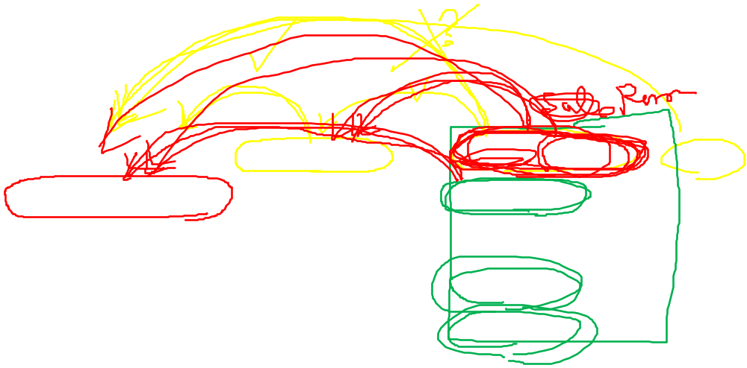
An example
Order # | Customer | Contact Person | Total
1 | Acme Widgets | John Doe | $134.23
2 | ABC Corporation | Fred Flintstone | $521.24
3 | Acme Widgets | John Doe | $1042.42
4 | Acme Widgets | John Doe | $928.53
The relation is in First Normal Form, but not Second Normal Form:
Remove subsets of data that apply to multiple rows of a table and place them in separate tables

Slide 30
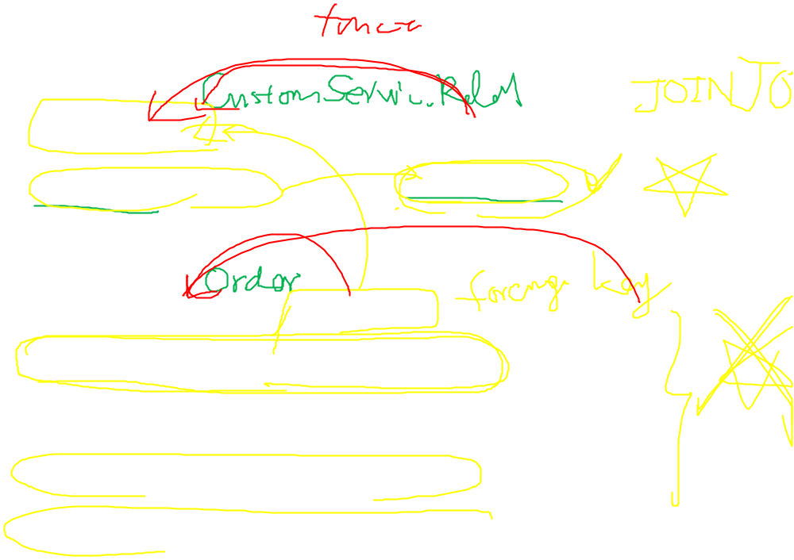
Two tables to satisfy 2NF
Customer | Contact Person
Acme Widgets | John Doe
ABC Corporation | Fred Flintstone
Order # | Customer | Total
1 | Acme Widgets | $134.23
2 | ABC Corporation | $521.24
3 | Acme Widgets | $1042.42
4 | Acme Widgets | $928.53

Slide 31

comments
The creation of two separate tables eliminates the dependency problem experienced in the previous case.
In the first table, contact person is dependent upon the primary key -- customer name.The second table only includes the information unique to each order.
Someone interested in the contact person for each order could obtain this information by performing a JOIN operation

Slide 32
3RD NF
Definition: In order to be in Third Normal Form, a relation must first fulfill the requirements to be in Second Normal Form.?Additionally, Every non-prime attribute of R is non-transitively dependent (i.e. directly dependent) on every candidate key of R.
A short explanation: No Dependencies on Non-Key Attributes

Slide 33
In the relational model of databases, a candidate key of a relation is a minimal superkey for that relation; that is, a set of attributes such that
the relation does not have two distinct tuples (i.e. rows or records in common database language) with the same values for these attributes (which means that the set of attributes is a superkey)
there is no proper subset of these attributes for which (1) holds (which means that the set is minimal).
The constituent attributes are called prime attributes. Conversely, an attribute that does not occur in ANY candidate key is called a non-prime attribute.

Slide 34
An example
Company | City | State | ZIP
Acme Widgets | New York | NY | 10169
ABC Corporation | Miami | FL | 33196
XYZ, Inc. | Columbia | MD | 21046

Slide 35
The answer
In this example, the city and state are dependent upon the ZIP code.?To place this table in 3NF, two separate tables would be created -- one containing the company name and ZIP code and the other containing city, state, ZIP code pairings.

Slide 36
To go or not to go higher?
This may seem overly complex for daily applications and indeed it may be. Database designers should always keep in mind the tradeoffs between higher level normal forms and the resource issues that complexity creates.
For example, in the last slide, if the city name and state name shall never change in 1000 years, the only harm is the duplication of data. The impact of change is of 0 possibility.

Slide 37
An exercise
(20分) 假設你負責分析一個系統，此系統的資料包含了下面許多欄位
Please analyze a system which contains the following attributes
  S#: 零件供應商的編號(Supplier no)
  SNAME: 零件供應商的姓名(supplier name)
  CITY1 零件供應商的城市(The city of a supplier)
  P# 零件編號 (part no.)
  PNAME 零件名稱 (part name)
  COLOR 零件色彩 (part color)
  WEIGHT 零件重量 (part weight)
  CITY2 零件所儲存的城市 (city where the parts are stored)
  QTY 零件的存量 (The quantity of the parts)
  In your analysis, you found that a part can be supplied by several suppliers. Please determine how many tables should be used and what is the content of each table.
在你分析的過程中，你發現一個零件可能有多個供應商可以供應。請簡單說明這樣一個資料庫系統，你要用幾個表格，每個表格的屬性又為何？

